Slide 1
Principles of Programming
Operators

Slide 2
Contents
Operators
Arithmetic Operators
Relational Operators
Logical Operators
Increment and Decrement Operators

Slide 3
Operators
An operator is a symbol, which helps the user to command the computer to do a certain mathematical or logical manipulations.
Operators are used in programming language program to operate on data and variables.

Slide 4
Operators
Operators can be classified as:
– Arithmetic operators
– Relational Operators
– Logical Operators
– Increments and Decrement Operators
-Assignment operators

Slide 5
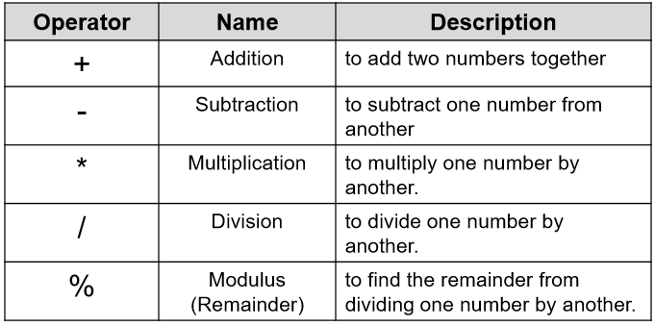
Arithmetic Operators
You can use an arithmetic operator with one or two arguments to add, subtract, multiply, and divide numeric values.

Slide 6
Arithmetic Operators
Example:
5 + 3 = 8
5 – 3 = 2
5 * 3 = 15
5 / 3 = 1
5 % 3 = 2

Slide 7
Arithmetic Operators
*, / and % will be performed before + or - in any expression.
Brackets can be used to force a different order of evaluation to this.
Example
  2 + 5 * 4 – 3 = ?
  (2 + 5) * (4 – 3) =

Slide 8
Arithmetic Operators
Here are some arithmetic expressions used within assignment statements:
z = x + y
no1 = x – y
age = a * b + c
velocity = distance / time
force = mass * acceleration
count = count + 1

Slide 9
Arithmetic Operators
Integer Arithmetic
When an arithmetic operation is performed on two whole numbers or integers than such an operation is called as integer arithmetic.
It always gives an integer as the result.

Slide 10
Arithmetic Operators
Example
Let x = 27 and y = 5 be two integer numbers. Then the integer operation leads to the following results:
x + y = 32
x – y = 22
x * y = 115
x % y = 2
x / y = 5

Slide 11
Arithmetic Operators
Floating-point Arithmetic
When an arithmetic operation is preformed on two real numbers or fraction numbers such an operation is called floating-point arithmetic.

Slide 12
Arithmetic Operators
Example
Let x = 14.0 and y = 4.0 then
x + y = 18.0
x – y = 10.0
x * y = 56.0
x / y = 3.50

Slide 13

Relational Operators
An operator that compares two values.
For example, the expression:
This expression will have a value of TRUE if the variable x is less than 5;
otherwise the value of the expression will be FALSE.

Slide 14
Relational Operators
Relational operators are sometimes called comparison operators.
Expressions that contain relational operators are called relational expressions.
A simple relational expression contains only one relational operator and takes the following form:
Where exp1 and exp2 are expressions, which may be simple constants, variables or combination of them.

Slide 15
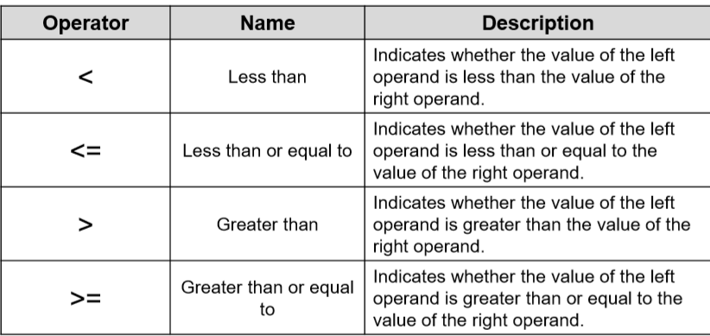
Relational Operators
The following are relational operators

Slide 16
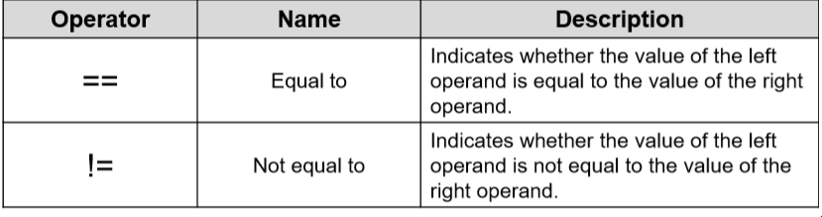
Relational Operators
The following are relational operators

Slide 17
Relational Operators
Example:
Let x = 2 and y = 5 then
x < y = True
(x + 2) > (y * 2) = False
(x + 3) <= y = True
x != y = True
y > (3 + x) = False

Slide 18
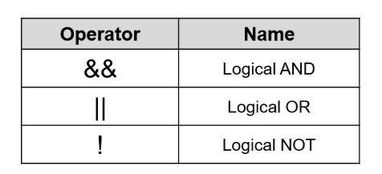
Logical Operators
An operator that compare or evaluate logical and relational expressions.
The following are logical operators:

Slide 19
Logical Operators
Logical AND
This operator is used to evaluate two conditions or expressions with relational operators simultaneously.
If both the expressions to the left and to the right of the logical operator is true then the whole compound expression is true.

Slide 20
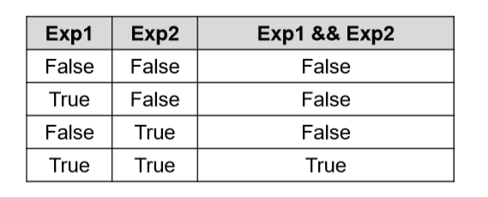
Logical Operators
Logical AND

Slide 21
Logical Operators
Logical AND
Example:
(a > b) && (x == 10)
The expression to the left is a > b and that on the right is x == 10, the whole expression is true only if both expressions are true i.e., if a is greater than b and x is equal to 10.

Slide 22
Logical Operators
Logical AND
Example:
Given a = 2, b = 3 and c = 5, evaluate the following logical expressions:
i. (a > b) && (c != 5) = False
ii. (a < b) && (c < b) = False
iii. (a > b) && (c == 5) = False
iv. (a < b) && (b < c) = True

Slide 23
Logical Operators
Logical OR
The logical OR is used to combine two expressions or the condition evaluates to true if any one of the 2 expressions is true.
The expression evaluates to true if any one of them is true or if both of them are true.

Slide 24
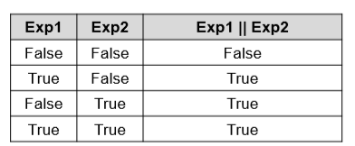
Logical Operators
Logical OR

Slide 25
Logical Operators
Logical OR
Example:
(a < m) || (a < n)
The expression evaluates to true if any one of them is true or if both of them are true.

Slide 26
Logical Operators
Logical OR
Example:
Given a = 2, b = 3 and c = 5, evaluate the following logical expressions:
i. (a > b) || (c != 5) = False
ii. (a < b) || (c < b) = True
iii. (a > b) || (c == 5) = True
iv. (a < b) || (b < c) = True

Slide 27

Logical Operators
Logical NOT
• The logical NOT operator takes single expression and evaluates to true if the expression is false and evaluates to false if the expression is true.
• In other words it just reverses the value of the expression.

Slide 28
Logical Operators
Logical NOT
Example:
! (x >= y)
The NOT expression evaluates to true only if the value of x is neither greater than or equal to y

Slide 29
Logical Operators
Logical NOT
Example:
Given a = 2, b = 3 and c = 5, evaluate the following logical expressions:
!(a > b) = True
!(a < b) = False
!(a > b || c == 5) = False

Slide 30
Logical Operators
Increment and Decrement Operators
• The increment and decrement operators are one of the unary operators which are very useful in programming language.
• They are extensively used in loops.
• The syntax of the operators is given below:
++ variable name, variable name++
– –variable name, variable name– –

Slide 31
Increment and Decrement Operators
Increment and Decrement Operators
• The increment operator ++ adds the value 1 to the current value of operand.
• The decrement operator – – subtracts the value 1 from the current value of operand.

Slide 32
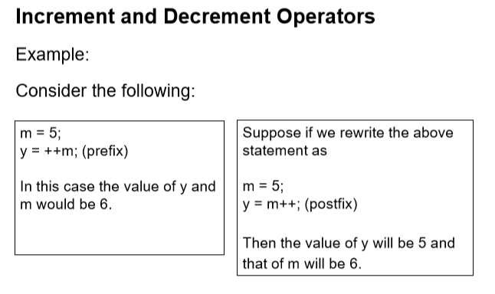
Increment and Decrement Operators

Slide 33
Increment and Decrement Operators
Increment and Decrement Operators
A prefix operator first adds 1 to the operand and then the result is assigned to the variable on the left.
On the other hand, a postfix operator first assigns the value to the variable on the left and then increments the operand.

Slide 34
Increment and Decrement Operators
Increment and Decrement Operators
Example 1:
x = 4 y = ++x PRINT x , PRINT y
What is the output?
5
5

Slide 35
Increment and Decrement Operators
Increment and Decrement Operators
Example 2:
x = 3 y = x++ PRINT x, PRINT y
What is the output?
3
4

Slide 36
Increment and Decrement Operators
Increment and Decrement Operators
Example 3:
x = 3 y = --x PRINT x , PRINT y
What is the output?
2
2

Slide 37
Increment and Decrement Operators
Increment and Decrement Operators
Example 4:
x = 3 y = x- - PRINT x, PRINT y
What is the output?
3
2

Slide 38
END

